Slide 1
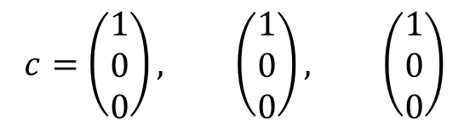
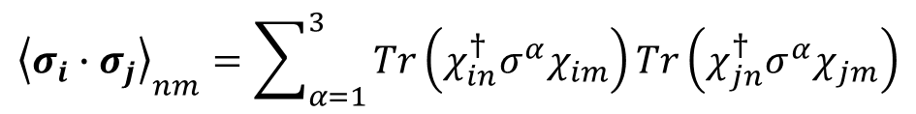
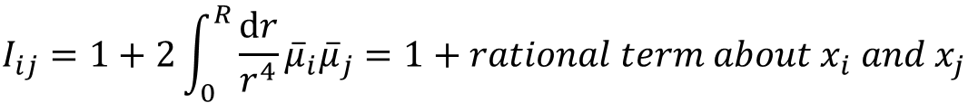
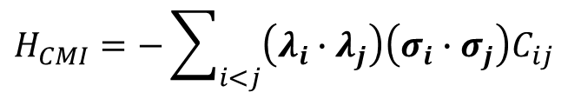
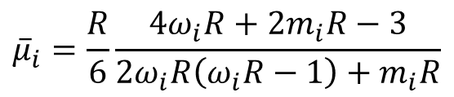

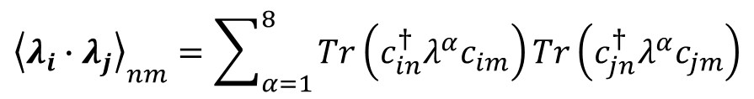
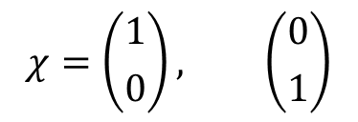
Chromomagnetic Interaction
$$H_{CMI}=−\sum_{i<j}{\left(λ_{i}∙λ_{j}\right)\left(σ_{i}∙σ_{j}\right)C_{ij}}$$
$$c=\left(\left.\begin{matrix}1 \\ 0 \\ 0\end{matrix}\right)\right., \left(\left.\begin{matrix}1 \\ 0 \\ 0\end{matrix}\right)\right., \left(\left.\begin{matrix}1 \\ 0 \\ 0\end{matrix}\right)\right.$$
$${\left\langle λ_{i}∙λ_{j}\right\rangle }_{nm}=\sum_{α=1}^{8}{Tr\left(c_{in}^{†}λ^{α}c_{im}\right)}Tr\left(c_{jn}^{†}λ^{α}c_{jm}\right)$$
$${\left\langle σ_{i}∙σ_{j}\right\rangle }_{nm}=\sum_{α=1}^{3}{Tr\left(χ_{in}^{†}σ^{α}χ_{im}\right)}Tr\left(χ_{jn}^{†}σ^{α}χ_{jm}\right)$$
$$χ=\left({1 \atop 0}\right), \left({0 \atop 1}\right)$$
$$C_{ij}=3\frac{α_{s}}{R^{3}}{\overline{μ}}_{i}{\overline{μ}}_{j}I_{ij}$$
$${\overline{μ}}_{i}=\frac{R}{6}\frac{4ω_{i}R+2m_{i}R−3}{2ω_{i}R\left(ω_{i}R−1\right)+m_{i}R}$$
$$I_{ij}=1+2\int_{0}^{R}{\frac{dr}{r^{4}}{\overline{μ}}_{i}{\overline{μ}}_{j}}=1+rational term about x_{i} and x_{j}$$

Slide 2
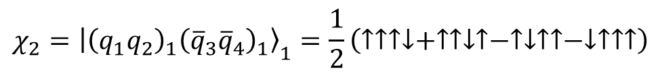
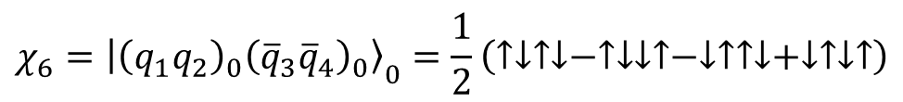
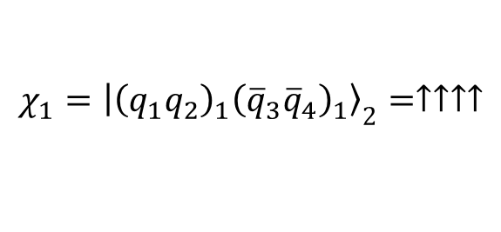
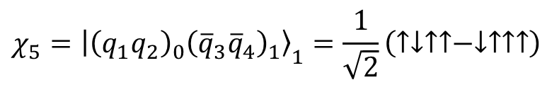
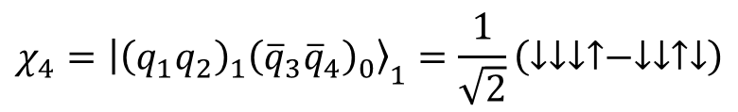
Spin Wave Function
$$χ_{1}={\left|\left.{\left(q_{1}q_{2}\right)}_{1}{\left({\overline{q}}_{3}{\overline{q}}_{4}\right)}_{1}\right\rangle \right.}_{2}=↑↑↑↑$$
$$χ_{2}={\left|\left.{\left(q_{1}q_{2}\right)}_{1}{\left({\overline{q}}_{3}{\overline{q}}_{4}\right)}_{1}\right\rangle \right.}_{1}=\frac{1}{2}\left(↑↑↑↓+↑↑↓↑−↑↓↑↑−↓↑↑↑\right)$$
$$χ_{3}={\left|\left.{\left(q_{1}q_{2}\right)}_{1}{\left({\overline{q}}_{3}{\overline{q}}_{4}\right)}_{1}\right\rangle \right.}_{0}=\frac{1}{\sqrt{3}}\left(↑↑↓↓+↓↓↑↑\right)−\frac{1}{2\sqrt{3}}\left(↑↓↑↓+↑↓↓↑+↓↑↑↓+↓↑↓↑\right)$$
$$χ_{4}={\left|\left.{\left(q_{1}q_{2}\right)}_{1}{\left({\overline{q}}_{3}{\overline{q}}_{4}\right)}_{0}\right\rangle \right.}_{1}=\frac{1}{\sqrt{2}}\left(↓↓↓↑−↓↓↑↓\right)$$
$$χ_{5}={\left|\left.{\left(q_{1}q_{2}\right)}_{0}{\left({\overline{q}}_{3}{\overline{q}}_{4}\right)}_{1}\right\rangle \right.}_{1}=\frac{1}{\sqrt{2}}\left(↑↓↑↑−↓↑↑↑\right)$$
$$χ_{6}={\left|\left.{\left(q_{1}q_{2}\right)}_{0}{\left({\overline{q}}_{3}{\overline{q}}_{4}\right)}_{0}\right\rangle \right.}_{0}=\frac{1}{2}\left(↑↓↑↓−↑↓↓↑−↓↑↑↓+↓↑↓↑\right)$$

Slide 3
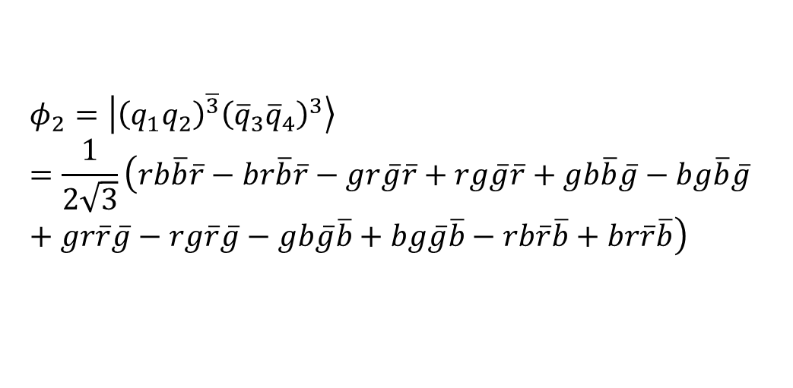
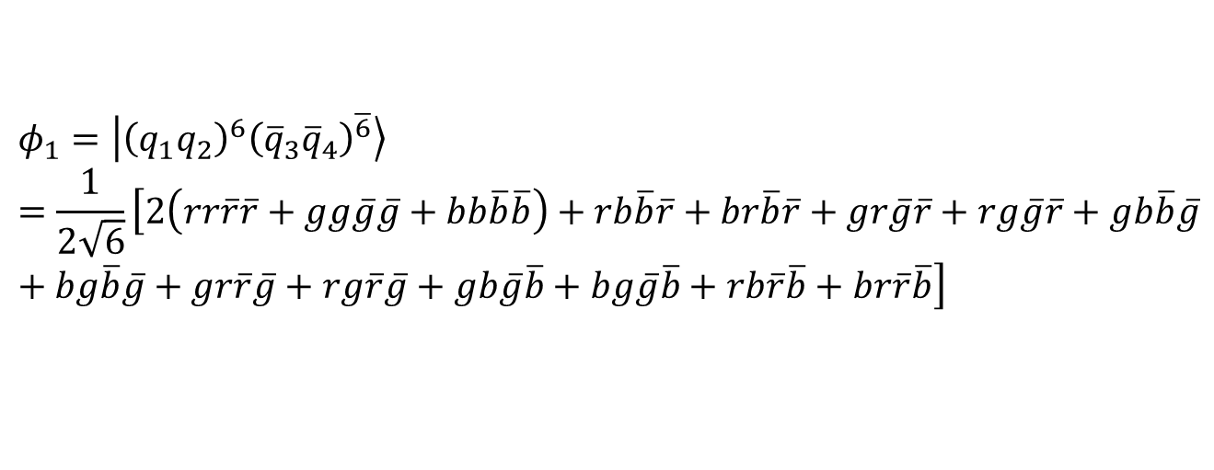
Color Wave Function
$$φ_{1}=\left|{\left(q_{1}q_{2}\right)}^{6}\left.{\left({\overline{q}}_{3}{\overline{q}}_{4}\right)}^{\overline{6}}\right\rangle \right.=\frac{1}{2\sqrt{6}}\left[2\left(rr\overline{r}\overline{r}+gg\overline{g}\overline{g}+bb\overline{b}\overline{b}\right)+rb\overline{b}\overline{r}+br\overline{b}\overline{r}+gr\overline{g}\overline{r}+rg\overline{g}\overline{r}+gb\overline{b}\overline{g}+bg\overline{b}\overline{g}+gr\overline{r}\overline{g}+rg\overline{r}\overline{g}+gb\overline{g}\overline{b}+bg\overline{g}\overline{b}+rb\overline{r}\overline{b}+br\overline{r}\overline{b}\right]$$
$$φ_{2}=\left|{\left(q_{1}q_{2}\right)}^{\overline{3}}\left.{\left({\overline{q}}_{3}{\overline{q}}_{4}\right)}^{3}\right\rangle \right.=\frac{1}{2\sqrt{3}}\left(rb\overline{b}\overline{r}−br\overline{b}\overline{r}−gr\overline{g}\overline{r}+rg\overline{g}\overline{r}+gb\overline{b}\overline{g}−bg\overline{b}\overline{g}+gr\overline{r}\overline{g}−rg\overline{r}\overline{g}−gb\overline{g}\overline{b}+bg\overline{g}\overline{b}−rb\overline{r}\overline{b}+br\overline{r}\overline{b}\right)$$

Slide 4
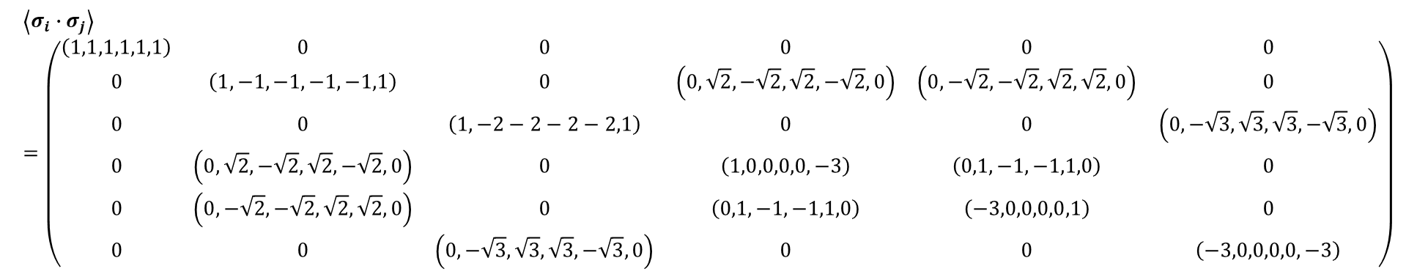



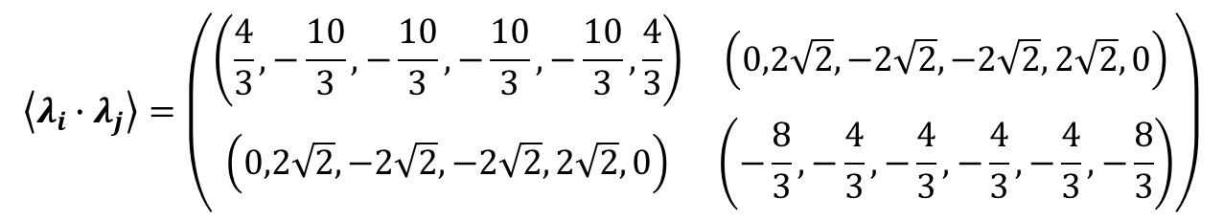
Coefficient Matrix for $q_{1}q_{2}{\overline{q}}_{3}{\overline{q}}_{4}$
$$\left\langle σ_{i}∙σ_{j}\right\rangle =\left(\begin{matrix}\left(1,1,1,1,1,1\right) & 0 & 0 & 0 & 0 & 0 \\ 0 & \left(1,−1,−1,−1,−1,1\right) & 0 & \left(0,\sqrt{2},−\sqrt{2},\sqrt{2},−\sqrt{2},0\right) & \left(0,−\sqrt{2},−\sqrt{2},\sqrt{2},\sqrt{2},0\right) & 0 \\ 0 & 0 & \left(1,−2−2−2−2,1\right) & 0 & 0 & \left(0,−\sqrt{3},\sqrt{3},\sqrt{3},−\sqrt{3},0\right) \\ 0 & \left(0,\sqrt{2},−\sqrt{2},\sqrt{2},−\sqrt{2},0\right) & 0 & \left(1,0,0,0,0,−3\right) & \left(0,1,−1,−1,1,0\right) & 0 \\ 0 & \left(0,−\sqrt{2},−\sqrt{2},\sqrt{2},\sqrt{2},0\right) & 0 & \left(0,1,−1,−1,1,0\right) & \left(−3,0,0,0,0,1\right) & 0 \\ 0 & 0 & \left(0,−\sqrt{3},\sqrt{3},\sqrt{3},−\sqrt{3},0\right) & 0 & 0 & \left(−3,0,0,0,0,−3\right)\end{matrix}\right)$$
$$\left\langle λ_{i}∙λ_{j}\right\rangle =\left(\begin{matrix}\left(\frac{4}{3},−\frac{10}{3},−\frac{10}{3},−\frac{10}{3},−\frac{10}{3},\frac{4}{3}\right) & \left(0,2\sqrt{2},−2\sqrt{2},−2\sqrt{2},2\sqrt{2},0\right) \\ \left(0,2\sqrt{2},−2\sqrt{2},−2\sqrt{2},2\sqrt{2},0\right) & \left(−\frac{8}{3},−\frac{4}{3},−\frac{4}{3},−\frac{4}{3},−\frac{4}{3},−\frac{8}{3}\right)\end{matrix}\right)$$
$$\left(C_{12},C_{13},C_{14},C_{23},C_{24},C_{34}\right)$$
$$\left(B_{12},B_{13},B_{14},B_{23},B_{24},B_{34}\right)$$

Slide 5
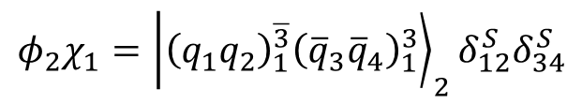
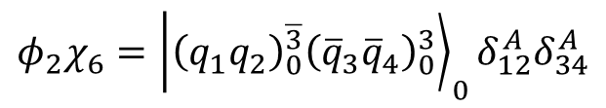
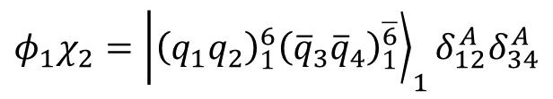
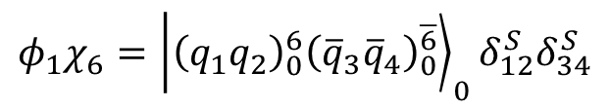
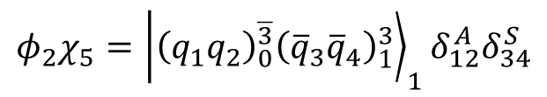
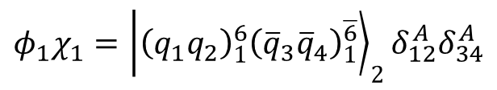
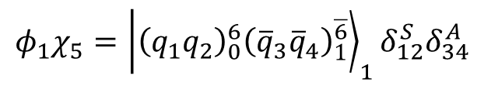
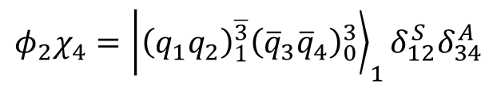
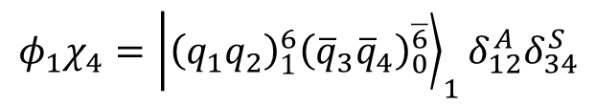
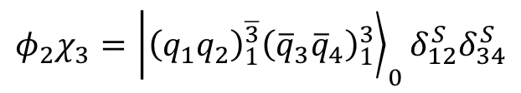
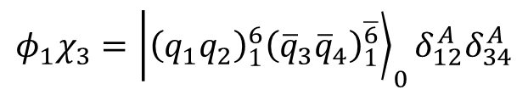
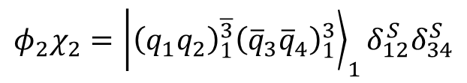
Flavor & Spin & Color Wave Function
$$φ_{1}χ_{1}={\left|\left.{\left(q_{1}q_{2}\right)}_{1}^{6}{\left({\overline{q}}_{3}{\overline{q}}_{4}\right)}_{1}^{\overline{6}}\right\rangle \right.}_{2}δ_{12}^{A}δ_{34}^{A}$$
$$φ_{2}χ_{1}={\left|\left.{\left(q_{1}q_{2}\right)}_{1}^{\overline{3}}{\left({\overline{q}}_{3}{\overline{q}}_{4}\right)}_{1}^{3}\right\rangle \right.}_{2}δ_{12}^{S}δ_{34}^{S}$$
$$φ_{1}χ_{2}={\left|\left.{\left(q_{1}q_{2}\right)}_{1}^{6}{\left({\overline{q}}_{3}{\overline{q}}_{4}\right)}_{1}^{\overline{6}}\right\rangle \right.}_{1}δ_{12}^{A}δ_{34}^{A}$$
$$φ_{2}χ_{2}={\left|\left.{\left(q_{1}q_{2}\right)}_{1}^{\overline{3}}{\left({\overline{q}}_{3}{\overline{q}}_{4}\right)}_{1}^{3}\right\rangle \right.}_{1}δ_{12}^{S}δ_{34}^{S}$$
$$φ_{1}χ_{3}={\left|\left.{\left(q_{1}q_{2}\right)}_{1}^{6}{\left({\overline{q}}_{3}{\overline{q}}_{4}\right)}_{1}^{\overline{6}}\right\rangle \right.}_{0}δ_{12}^{A}δ_{34}^{A}$$
$$φ_{2}χ_{3}={\left|\left.{\left(q_{1}q_{2}\right)}_{1}^{\overline{3}}{\left({\overline{q}}_{3}{\overline{q}}_{4}\right)}_{1}^{3}\right\rangle \right.}_{0}δ_{12}^{S}δ_{34}^{S}$$
$$φ_{1}χ_{4}={\left|\left.{\left(q_{1}q_{2}\right)}_{1}^{6}{\left({\overline{q}}_{3}{\overline{q}}_{4}\right)}_{0}^{\overline{6}}\right\rangle \right.}_{1}δ_{12}^{A}δ_{34}^{S}$$
$$φ_{2}χ_{4}={\left|\left.{\left(q_{1}q_{2}\right)}_{1}^{\overline{3}}{\left({\overline{q}}_{3}{\overline{q}}_{4}\right)}_{0}^{3}\right\rangle \right.}_{1}δ_{12}^{S}δ_{34}^{A}$$
$$φ_{1}χ_{5}={\left|\left.{\left(q_{1}q_{2}\right)}_{0}^{6}{\left({\overline{q}}_{3}{\overline{q}}_{4}\right)}_{1}^{\overline{6}}\right\rangle \right.}_{1}δ_{12}^{S}δ_{34}^{A}$$
$$φ_{2}χ_{5}={\left|\left.{\left(q_{1}q_{2}\right)}_{0}^{\overline{3}}{\left({\overline{q}}_{3}{\overline{q}}_{4}\right)}_{1}^{3}\right\rangle \right.}_{1}δ_{12}^{A}δ_{34}^{S}$$
$$φ_{1}χ_{6}={\left|\left.{\left(q_{1}q_{2}\right)}_{0}^{6}{\left({\overline{q}}_{3}{\overline{q}}_{4}\right)}_{0}^{\overline{6}}\right\rangle \right.}_{0}δ_{12}^{S}δ_{34}^{S}$$
$$φ_{2}χ_{6}={\left|\left.{\left(q_{1}q_{2}\right)}_{0}^{\overline{3}}{\left({\overline{q}}_{3}{\overline{q}}_{4}\right)}_{0}^{3}\right\rangle \right.}_{0}δ_{12}^{A}δ_{34}^{A}$$

Slide 6
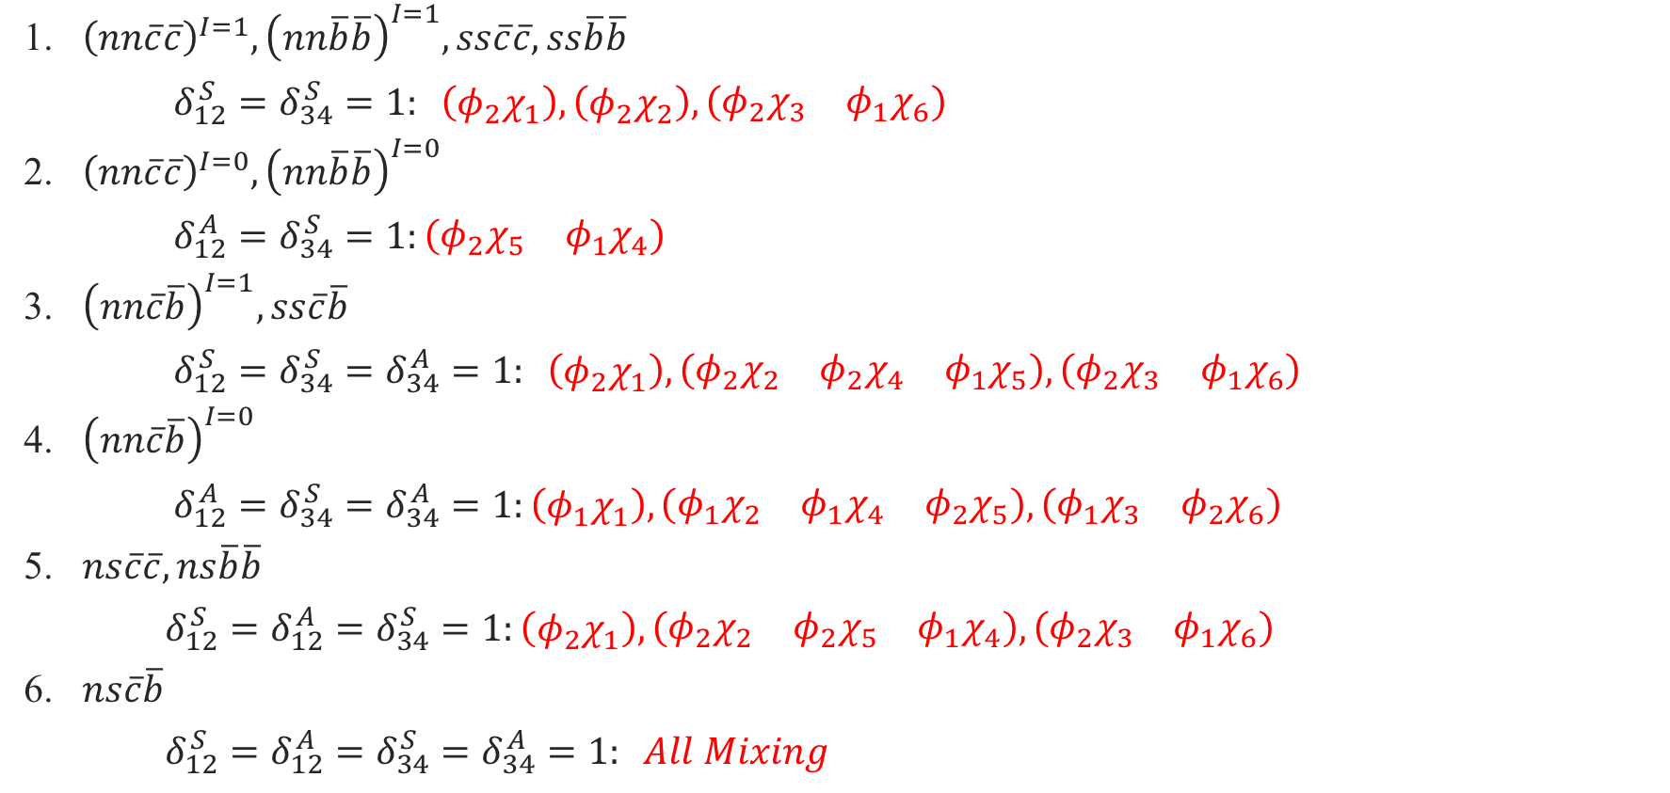
Candidates
1. ${\left(nn\overline{c}\overline{c}\right)}^{I=1},{\left(nn\overline{b}\overline{b}\right)}^{I=1},ss\overline{c}\overline{c},ss\overline{b}\overline{b}$
$δ_{12}^{S}=δ_{34}^{S}=1: \left(φ_{2}χ_{1}\right),\left(φ_{2}χ_{2}\right), \left(\begin{matrix}φ_{2}χ_{3} & φ_{1}χ_{6}\end{matrix}\right)$
2. ${\left(nn\overline{c}\overline{c}\right)}^{I=0},{\left(nn\overline{b}\overline{b}\right)}^{I=0}$
$δ_{12}^{A}=δ_{34}^{S}=1:\left(\begin{matrix}φ_{2}χ_{5} & φ_{1}χ_{4}\end{matrix}\right)$
3. ${\left(nn\overline{c}\overline{b}\right)}^{I=1},ss\overline{c}\overline{b}$
$δ_{12}^{S}=δ_{34}^{S}=δ_{34}^{A}=1: \left(φ_{2}χ_{1}\right),\left(\begin{matrix}φ_{2}χ_{2} & φ_{2}χ_{4} & φ_{1}χ_{5}\end{matrix}\right),\left(\begin{matrix}φ_{2}χ_{3} & φ_{1}χ_{6}\end{matrix}\right)$
4. ${\left(nn\overline{c}\overline{b}\right)}^{I=0}$
$δ_{12}^{A}=δ_{34}^{S}=δ_{34}^{A}=1:\left(φ_{1}χ_{1}\right),\left(\begin{matrix}φ_{1}χ_{2} & φ_{1}χ_{4} & φ_{2}χ_{5}\end{matrix}\right),\left(\begin{matrix}φ_{1}χ_{3} & φ_{2}χ_{6}\end{matrix}\right)$
5. $ns\overline{c}\overline{c},ns\overline{b}\overline{b}$
$δ_{12}^{S}=δ_{12}^{A}=δ_{34}^{S}=1:\left(φ_{2}χ_{1}\right),\left(\begin{matrix}φ_{2}χ_{2} & φ_{2}χ_{5} & φ_{1}χ_{4}\end{matrix}\right),\left(\begin{matrix}φ_{2}χ_{3} & φ_{1}χ_{6}\end{matrix}\right)$
6. $ns\overline{c}\overline{b}$
$δ_{12}^{S}=δ_{12}^{A}=δ_{34}^{S}=δ_{34}^{A}=1: All Mixing$

Slide 7
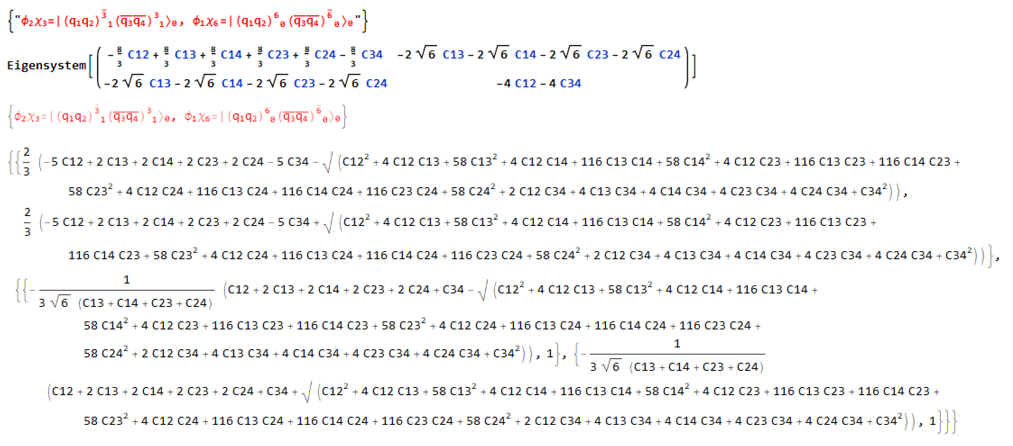

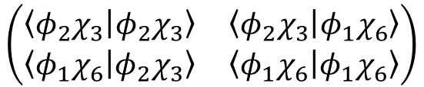
Mixing of CMI for $q_{1}q_{2}{\overline{q}}_{3}{\overline{q}}_{4}$
$$\left(\begin{matrix}\left\langle φ_{2}χ_{3} | φ_{2}χ_{3}\right\rangle & \left\langle φ_{2}χ_{3} | φ_{1}χ_{6}\right\rangle \\ \left\langle φ_{1}χ_{6} | φ_{2}χ_{3}\right\rangle & \left\langle φ_{1}χ_{6} | φ_{1}χ_{6}\right\rangle \end{matrix}\right)$$

Slide 8
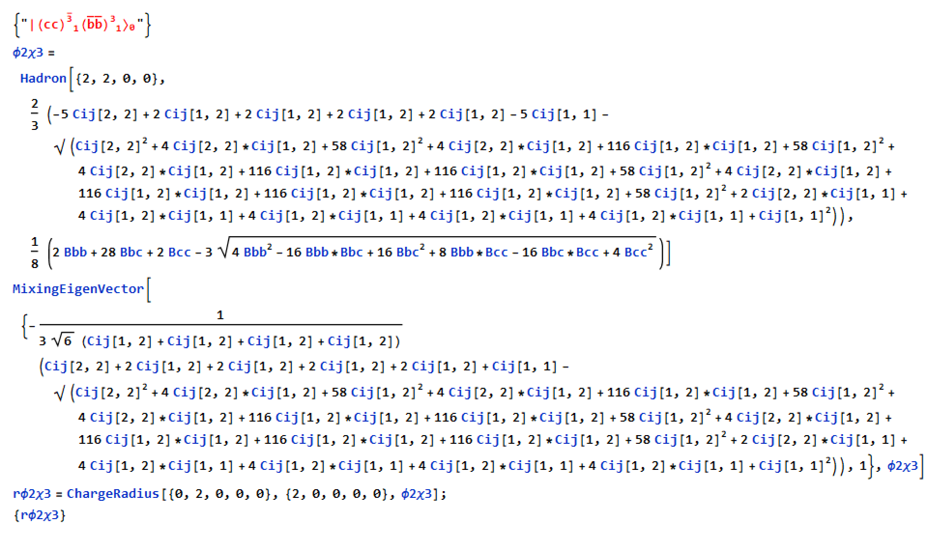
Programing

Slide 9
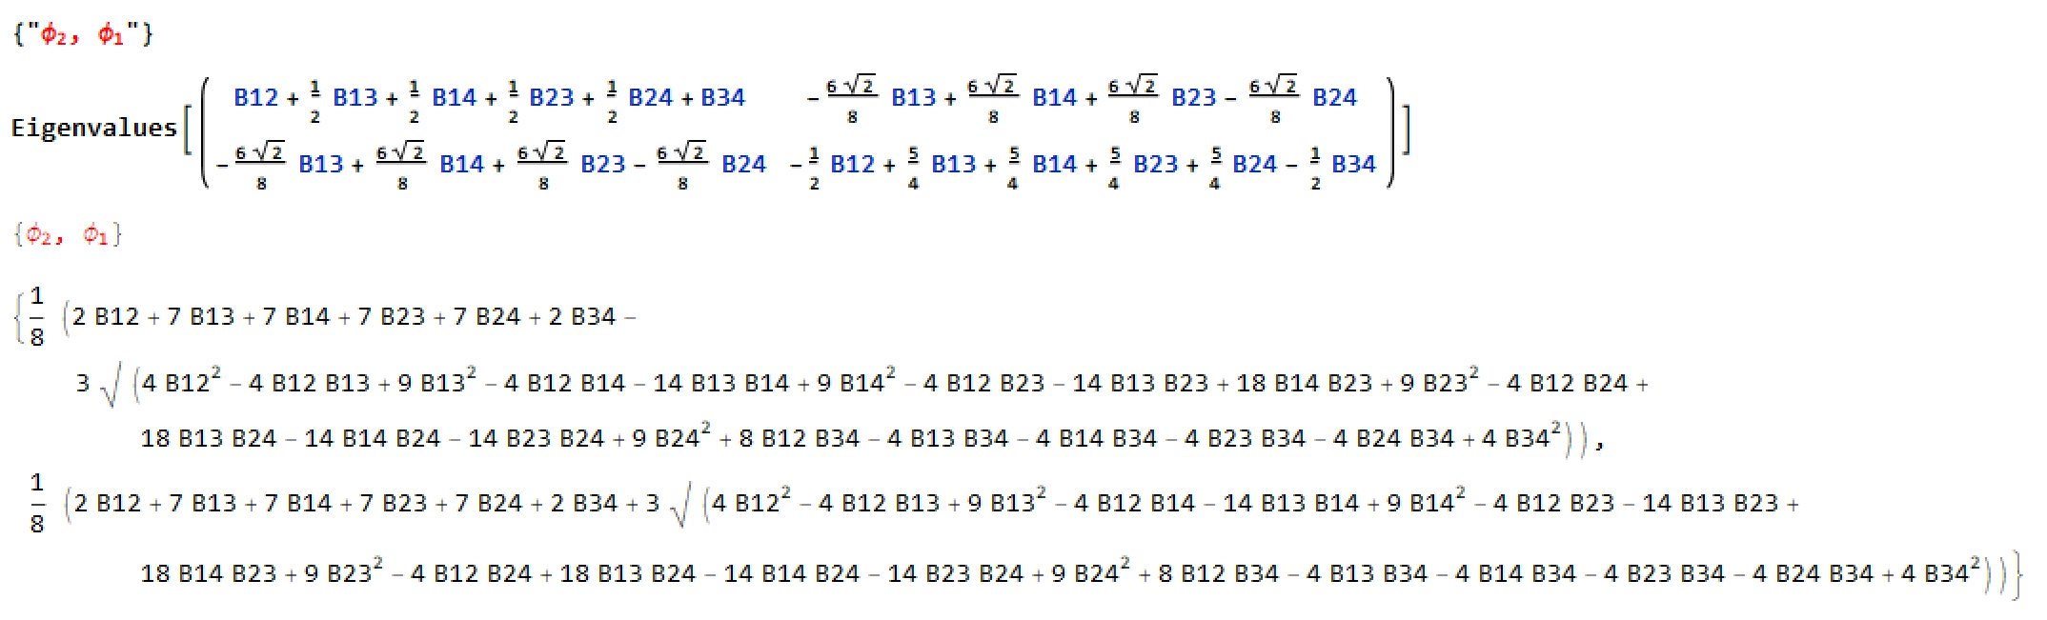
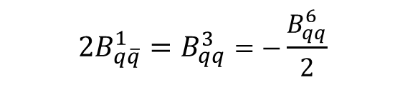


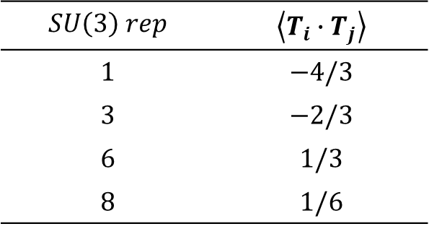
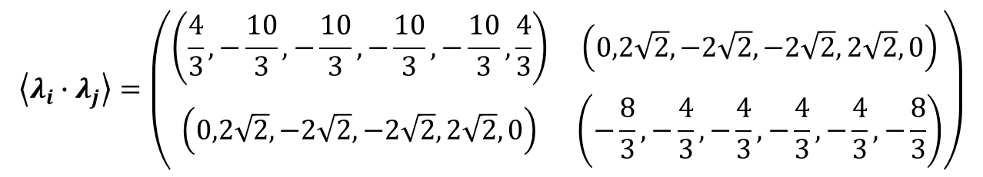
Mixing of Binding for $q_{1}q_{2}{\overline{q}}_{3}{\overline{q}}_{4}$
$$T=\frac{λ}{2}$$
$$SU\left(3\right) rep$$ | $$\left\langle T_{i}∙T_{j}\right\rangle$$
$$1$$ | $$−4/3$$
$$3$$ | $$−2/3$$
$$6$$ | $$1/3$$
$$8$$ | $$1/6$$
$$\left\langle λ_{i}∙λ_{j}\right\rangle =\left(\begin{matrix}\left(\frac{4}{3},−\frac{10}{3},−\frac{10}{3},−\frac{10}{3},−\frac{10}{3},\frac{4}{3}\right) & \left(0,2\sqrt{2},−2\sqrt{2},−2\sqrt{2},2\sqrt{2},0\right) \\ \left(0,2\sqrt{2},−2\sqrt{2},−2\sqrt{2},2\sqrt{2},0\right) & \left(−\frac{8}{3},−\frac{4}{3},−\frac{4}{3},−\frac{4}{3},−\frac{4}{3},−\frac{8}{3}\right)\end{matrix}\right)$$
$$2B_{q\overline{q}}^{1}=B_{qq}^{3}=−\frac{B_{qq}^{6}}{2}$$

